Slide 1
Consumer Behavior 15.847
Lecture 3
Heuristics and Biases I

Slide 2
Last Time
Two Systems: Intuition vs Reason
→ Trade-off between ease and flexibility
Heuristics
→ Rules of thumb for easy decision-making
Biases
→ Predictable errors arising from reliance on heuristics

Slide 3
Real-world CRT correlates
Income
Trading/financial performance
Ability to price assets
Ability to select and evaluate teams
High anxiety / depression
Weight on quality and brand information
Price sensitivity
Resistance to most of the biases we’ll discuss

Slide 4
Explicit Heuristics
50/30/20 Rule (Budgeting)
50% for necessities (housing & bills)
20% for financial goals (saving & retirement)
30% for wants (restaurants & entertainment)
20/4/10 Rule (Buying a car)
≥20% down payment
≤4 years of financing
≤10% of gross income on transportation costs

Slide 5
But mostly we are interested in heuristics people do not realize they are applying

Slide 6
Social Heuristics
There are typically future consequences for our social actions
→ Heuristic = assume interactions are repeated
Intuition = don’t upset people
Reason = sometimes you can get away with not being nice

Slide 7
Anchoring
1st Question Is the average price of a new car more or less than $20,000 [$40,000]?
2nd Question What is the average price of a new car?
$20,000 Anchor = Estimate $32,602
$40,000 Anchor = Estimate $36,854

Slide 8
Anchoring
Anchor increases the cognitive accessibility of cheap vs. expensive cars, influences absolute estimate.
$20,000 Anchor
Cues: Kia, Subaru, Volkswagen, Hyundai, Nissan, Toyota
Inhibits: Lexus, Mercedes, BMW , Cadillac
= Estimate $32,602
$40,000 Anchor
Cues: Lexus, Mercedes, BMW , Cadillac
Inhibits: Kia, Subaru, Volkswagen, Hyundai, Nissan, Toyota = Estimate $36,854

Slide 9
Anchoring (and adjustment)
Also see anchoring effects in domains without these kinds of associations (e.g. trivia questions)
Anchor itself is extremely cognitively accessible
So when the question is hard, your mind starts at the anchor, and then starts adjusting
→ “$20,000 seems low”, start adjusting up
→ “$40,000 seems high”, start adjusting down
Either way, don’t adjust far enough

Slide 10
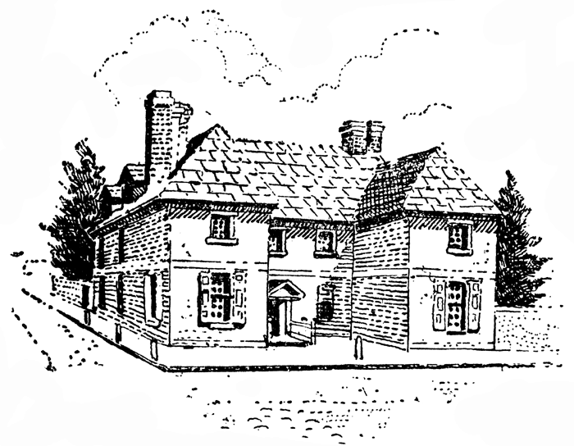
Do Experts Anchor?
Standard Multiple Listing Service (MLS) sheet for the property
A copy of the MLS summary of residential real estate sales for the entire city and the immediate neighborhood for the last 6 months
Information (e.g., listing price, square footage, characteristics of the property) about other property located in the same neighborhood as the property being evaluated. This information was divided into four categories: property currently for sale, property recently sold, property sold but the sale not yet completed, and property previously listed which did not sell
Standard MLS listing information for other property in the immediate neighborhood currently for sale → $65,900 or $83,900
ACTUAL LISTING:
$74,900

Slide 11
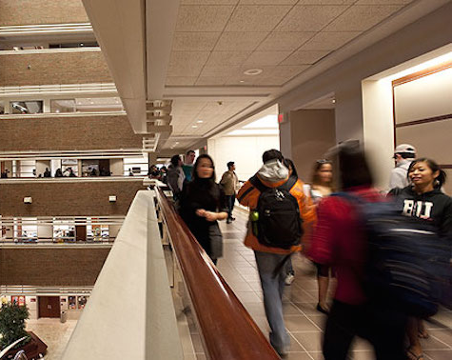

Do Experts Anchor?
NOVICES
Undergraduate junior and senior majors in Business
EXPERTS
Volunteer real estate agents with an average sales experience of 7 years

Slide 12
Undergraduates
Anchor | Appraisal Value | Listing Price | Purchase Price | Lowest Offer
$65,900 | $63,571 | $69,414 | $63,571 | $62,571
$83,900 | $72,196 | $78,104 | $69,500 | $69,785
Real Estate Agents
Anchor | Appraisal Value | Listing Price | Purchase Price | Lowest Offer
$65,900 | $67,811 | $69,996 | $66,755 | $65,000
$83,900 | $75,190 | $76,380 | $73,000 | $72,590

Slide 13
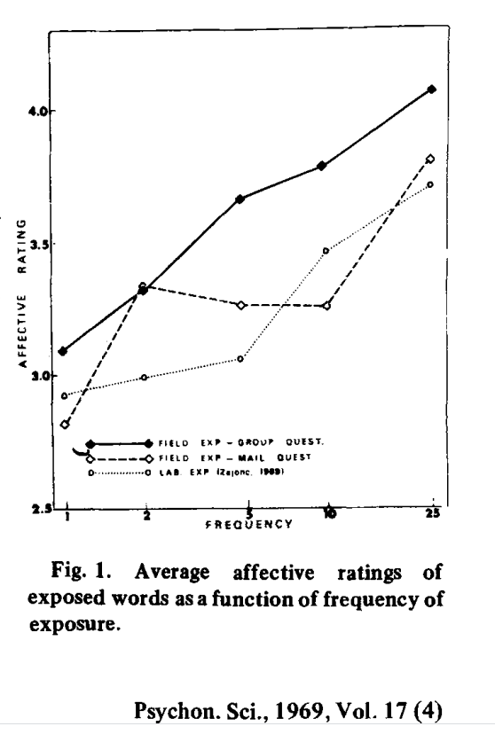
Mere Exposure Effect
Five Turkish words embedded at different frequencies in school newspaper ads
Students subsequently given questionnaire asking them to guess if each word “means something 'good' or something 'bad.‘”

Slide 14
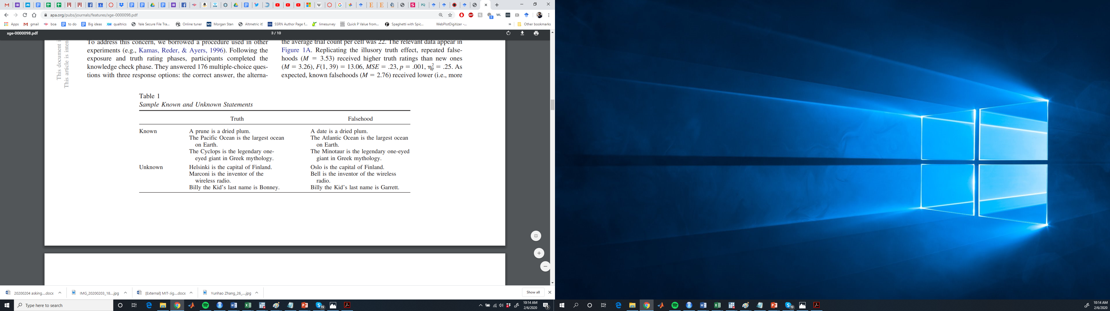
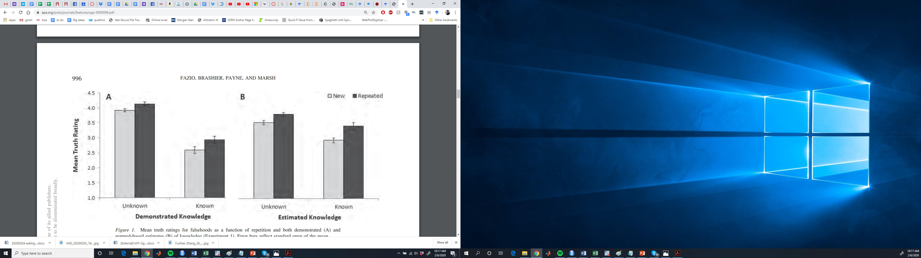
Illusory Truth Effect
Falsehoods
Fa
New
Repeated
Fazio et al 2015

Slide 15
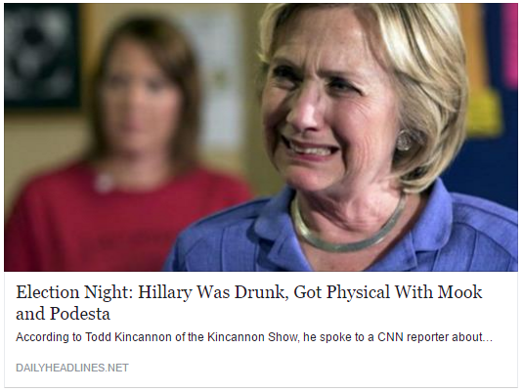
Illusory Truth Effect
Pennycook et al 2018

Slide 16
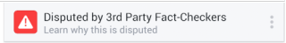
Illusory Truth Effect
Significant for both politically concordant and discordant headlines
Compounds over multiple exposures, still evident in 1-week follow-up

Slide 17
What’s going on?
Things you’ve seen before come more quickly to mind (are more “fluent”)
Fluency is used as a heuristic to infer positivity and truth

Slide 18
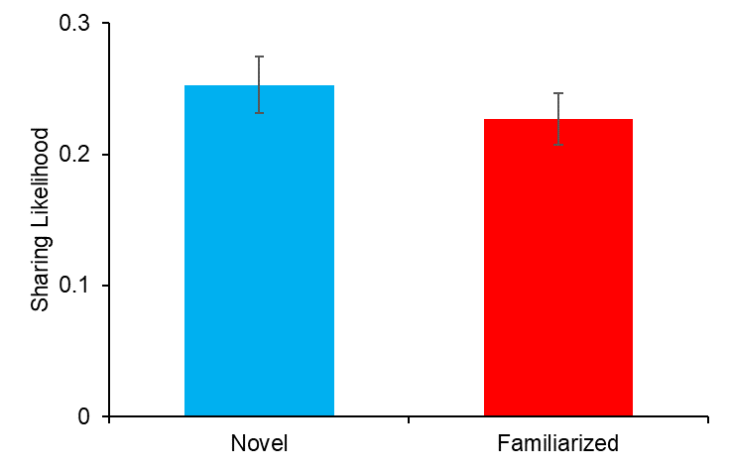
Sidebar: Exposure and sharing
Exposure increases belief
Exposure should also increase social media sharing intentions
…right?
Exposure = 10% decrease in sharing intentions!

Slide 19
Availability Heuristic
What is the deadliest animal in the world?

Slide 20
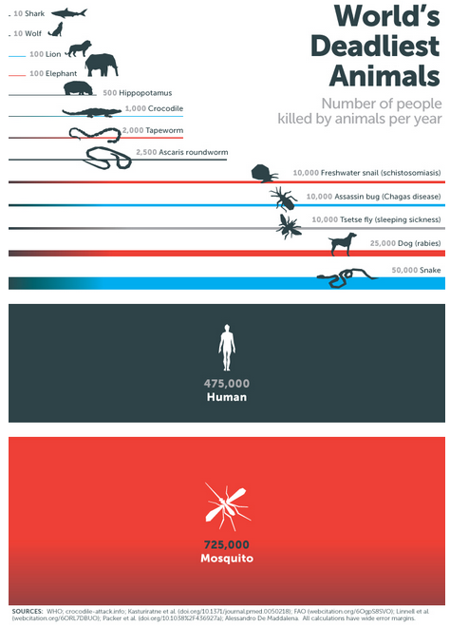

Slide 21

Availability Heuristic
“How much of the house upkeep work do you do?”
I do at least 75%.
I do at least 75%.
= 150%

Slide 22
Availability Heuristic
What percent of all seven letter words have…
__ __ __ __ __ n __
__ __ __ __ i n g
13%
8%

Slide 23
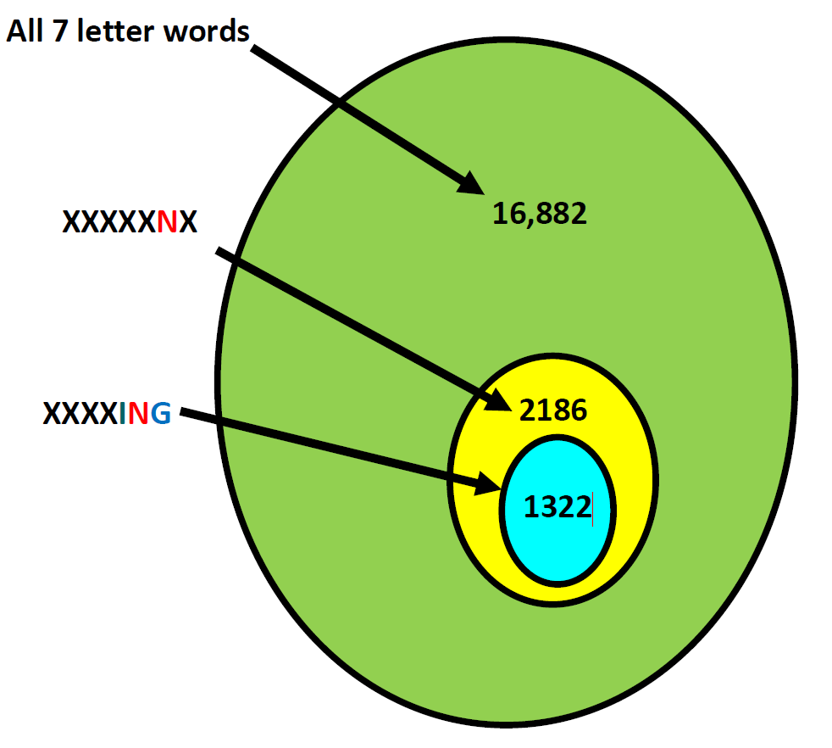

Slide 24
What’s going on?
Populations, frequencies, and percentages are difficult to assess.
Biased sample of information – that which comes to mind easily – is readily available and thus easy to asses

Slide 25
“The Linda Problem”
Linda is 31 years old, single, outspoken and very bright. She majored in philosophy. As a student she was deeply concerned with issues of discrimination and social justice and also participated in nuclear demonstrations.
Which is more likely? Linda is a bank teller Linda is a bank teller and a feminist
Kahneman & Tversky, 1973

Slide 26
The Conjunction Fallacy
Judging the conjunction of two events to be more probable than one of the constituent elements.
Believing p(B and F) > p(B) or p(F)
BANK TELLER
FEMINIST

Slide 27
What’s going on?
The probability of Linda having a given job is difficult to assess.
The similarity of Linda to stereotypes of jobs is easy to assess.

Slide 28
Base-Rate Neglect
In a study, 100 people were tested. Among the participants there were 30 engineers and 70 lawyers. Jack is a randomly chosen participant of this study.
Jack is 36 years old. He is not married and is somewhat introverted. He likes to spend his free time reading science fiction and writing computer programs.
What is more likely?
Jack is an engineer
Jack is a lawyer
Kahneman & Tversky, 1973

Slide 29
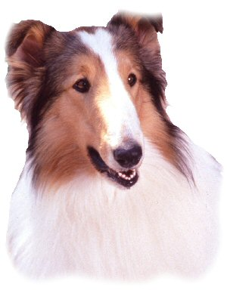
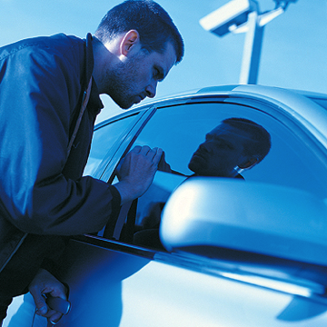
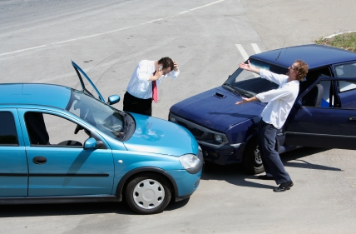
Base-Rate Neglect
Most dog bites (77%) are by dogs known to the victim
… and we’re most often near dogs we know
Honda Civics are one of the most commonly stolen cars
…and are one of the most popular models
Most car accidents take place within 5 minutes of home
…where we most often drive
Notes:
29
People ignore base rates when it comes to claims they hear in the media as well. A good deal of “scary” statistics can be explained very simply by base rates. People ignore base rates and evaluate information as it is given, rather than in comparison to a baseline.
Because we’re most often around dogs that we know….
Civics are frequently stolen, but they also have one of the leading market shares. More cars, greater likelihood to get stolen.
Car accidents? This is true, but the reason is that you are within 5 minutes of your house more than you are anywhere else.

Slide 30
Medical Testing
You test positive for a disease.
The disease affects 1 in 1000 people. The test is 95% accurate.
How likely are you to have the disease?
Notes:
Correct answer is 2% chance?

Slide 31
N = 100,000
N=100 N=99,900
Test Results | Have Disease | Do Not Have Disease
Positive | 95 | 4,995
Negative | 5 | 94,904
Probability you have the disease?
Negative result: 5/(5+94,904)=0.01%
Positive result: 95/(95+4,995)=1.9%
Notes:
Let’s assume a model where 100,000 people are tested for the diseased. Since the disease effects 1 in 1000 people, we would expect 100 people to have the disease. That means that 99,900 people would not have the disease. Of those 99,900, 4,995 people would receive a false positive diagnosis. That compares to only 95 people receiving a correct positive diagnosis. Therefore, the probability upon receiving a positive test that one actually has the disease is 1.9% (95/4,995).

Slide 32
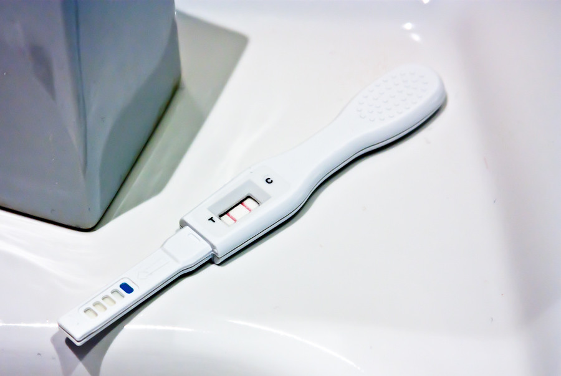
Pregnancy Test

Slide 33
What’s going on?
The focal information/data is presented directly to you and so comes automatically to mind.
Base rates are not mentioned, and so are easy to overlook. You need to actively incorporate them.
Bayes Rule = don’t neglect base rates!

Slide 34
Insensitivity to Sample Size
A certain town is served by two hospitals. In the larger hospital, ~45 babies are born each day and in the smaller one, ~15 babies are born each day. As you know, about 50% of all babies are boys. However, the exact % varies from day to day. Sometimes it may be higher than 50%, sometimes lower.
For one year, each hospital recorded the days in which more than 60% of the babies born were boys. Which hospital do you think recorded more such days?
The larger hospital
The smaller hospital
About the same (within 5% of each other)

Slide 35
Insensitivity to Sample Size
Obvious differences in the odds of getting more than 60% heads when we flip a coin:
3 times (fairly likely!)
3,000 times (very unlikely!)
In general, though, we ignore this information and assume sample size doesn’t matter
“Belief in the Law of Small Numbers”
Notes:
Ideas: Getting upset about some bad days at a smaller store relative to a larger one…

Slide 36
Halo Effect
Extending an evaluation of an observable attribute to the evaluation of an unknown attribute.
Using the attractive design of Apple products (observable) as a proxy for their reliability (unobservable).

Slide 37
Beauty Premium
Survey of 7,094 Americans and Canadians in 1971, 1977, 1981.
Backed out hourly wage from earnings data and survey-takers rated respondents’ attractiveness.
30% most attractive earn +5% per hour
10% least attractive earn –7 to -10% per hour
Hamermesch and Biddle 1993
Notes:
Hamermesch and Biddle 1993

Slide 38
Beauty Premium
986 PhD grads 2002-2006 from 10 top econ programs (80% M)
More attractive graduates…
→ Come from higher ranked PhD program
→ More likely to go into industry
→ Higher rank 1st & later academic jobs
→ Not more papers, but yes more citations
Hale Regev Rubinstein 2021
Notes:
Hamermesch and Biddle 1993

Slide 39
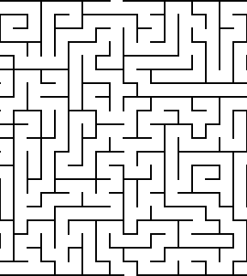
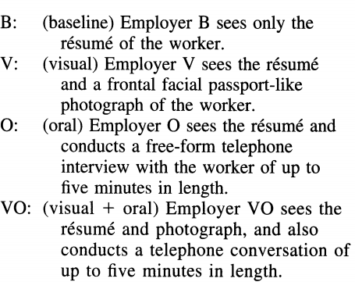
Beauty Premium
Mobius and Rosenblatt 2006
Mobius & Rosenblat 2006
Notes:
The task of each employer i is to estimate the expected productivity wij of each workerj in the 15-minute employment period. Employers are provided with the same incentives as workers to reveal truthfully their estimates. Employer i faces a penalty of 40 points for each mispredicted maze of worker j. For example, if em- ployer i decides that worker j can do eight mazes but the worker solves ten, then the em- ployer receives a penalty of 80 point

Slide 40
Beauty Premium (+1SD)
Increase in wages per 1 SD increase in beauty
Notes:
Percent increase in wages per 1 SD increase in beauty

Slide 41
Beauty and Ability
Notes:
Beautiful people don’t perform better, but believe they will.

Slide 42


Health Halo

Slide 43
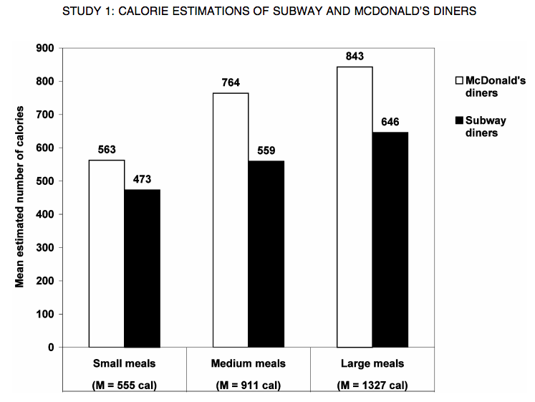
Health Halo

Slide 44
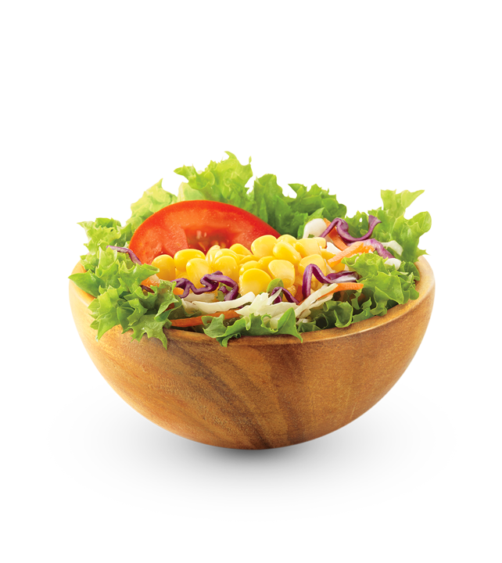
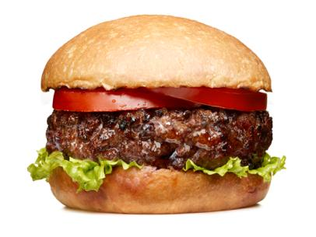
Dieter’s Paradox

Slide 45
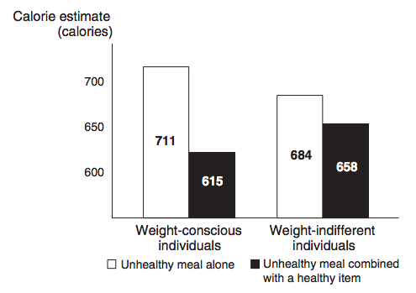
Dieter’s Paradox

Slide 46
What’s going on?
Ability and calories are difficult to assess.
Attractiveness or healthiness is easier to assess.

Slide 47

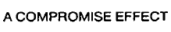
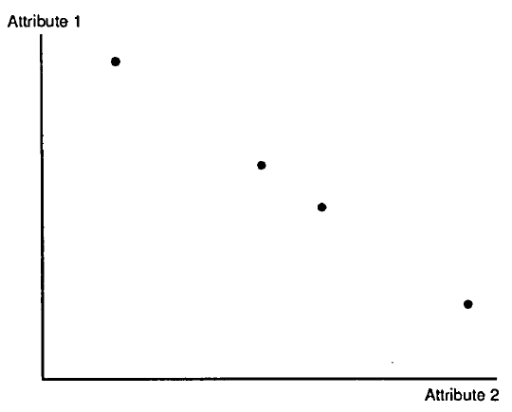
Compromise Effect
Middle options (compromises) often preferred more than extreme options
In the option set ABC, Option B will have a greater choice share
In the option set BCD, Option C will have a greater choice share
Options B and C do not change!
A
B
C
D

Slide 48
Compromise Effect
Model A
Processor Speed: 1.8 GHz
Price: $599
Model B
Processor Speed: 2.0 GHz
Price: $699
Model C
Processor Speed: 2.2 GHz
Price: $799
Model D
Processor Speed: 2.4 GHz
Price: $899
15%
50% | 24%
35% | 46%
 | 25%
Notes:
Caveat: works primarily for brands on equal footing with respect to familiarity

Slide 49
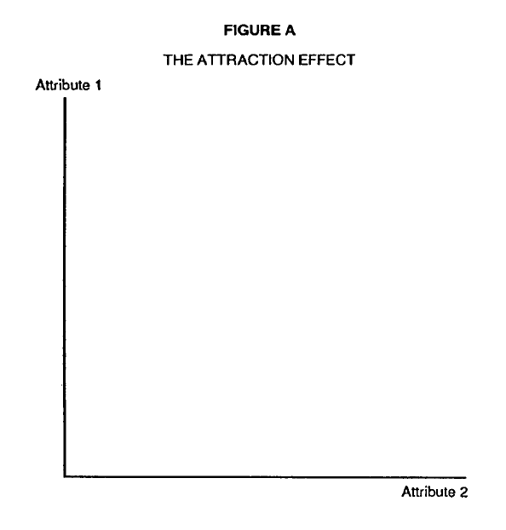
Attraction Effect
With options A & B, adding a 3rd inferior option (C) will increase share of nearer option
“Asymmetric dominance” or “decoy” effect
A
C
B
decoy

Slide 50
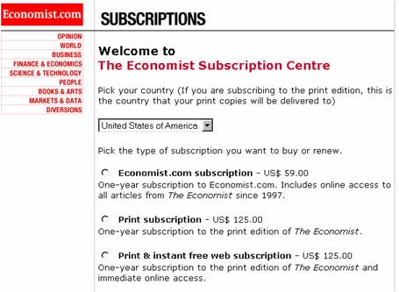
28%
0%
72%
57%
43%

Slide 51
Attraction Effect
Which, if any, portable PC you would buy:
Which, if any, portable PC you would buy:
1.6GHz $1500
1.75GHz $1800
1.8GHz $1800
1.6GHz $1500
1.8GHz $1800
A
B’
B
A
B
I would not buy any of the above
I would not buy any of the above
45%
0%
55%
85%
15%
Does adding a dominated option increase choice deferral?
No Choice: 21%
No Choice: 32%

Slide 52
but…
A lot of time you don’t actually find any effect
More importantly, can even get repulsion effect
→When the decoy tells you something about the quality target
→e.g. when both from same brand, and decoy is low quality (rather than high price)
Bhui Xiang 2021

Slide 53
TEAMS!

